Slide 1
GAME THEORY Solving 2 by 2 Matrix Games
Sri vatssan
40742

Slide 2
Table of Contents
01
03
The Strategic Form of a Game.
So that we can understand the concept
02
04
List of formula that we are going to use
To know the way of approach
Definition for Game Theory
Definitions for formula
Few examples
Formula

Slide 3
01
Definition
The Strategic Form of a Game.

Slide 4
Introduction
A game, in the mathematical sense, is a situation in which players make rational decisions according to defined rules in an attempt to receive some sort of payoff. Game theory is the branch of mathematics which focuses on the analysis of such games.

Slide 5
Strategic Form
For a two-person zero-sum game, the payoff function of Player II is the negative of the payoff of Player I, so we may restrict attention to the single payoff function of Player I, which we call here L.

Slide 6
Definition:-
The strategic form, or normal form, of a two-person zero-sum game is given by a triplet (X, Y, L), where
(1) X is a nonempty set, the set of strategies of Player I
(2) Y is a nonempty set, the set of strategies of Player II
(3) L is a real-valued function defined on X × Y . (Thus, L(x, y) is a real number for every x ∈ X and every y ∈ Y .)

Slide 7
Odd or Even
Players I and II simultaneously call out one of the numbers one or two. Player I’s name is Odd; he wins if the sum of the numbers if odd. Player II’s name is Even; she wins if the sum of the numbers is even. The amount paid to the winner by the loser is always the sum of the numbers in dollars. To put this game in strategic form we must specify X, Y and L. Here we may choose X = {1, 2}, Y = {1, 2}, and L as given in the following table.

Slide 8
Example:-
II (even) y
( )
L(x, y) = I’s winnings = II’s losses.
It turns out that one of the players has a distinct advantage in this game. Can you tell which one it is? Let us analyze this game from Player I’s point of view. Suppose he calls ‘one’ 3/5ths of the time and ‘two’ 2/5ths of the time at random. In this case,
1. If II calls ‘one’, I loses 2 dollars 3/5ths of the time and wins 3 dollars 2/5ths of the time; on the average, he wins −2(3/5) + 3(2/5) = 0 (he breaks even in the long run).
2. If II call ‘two’, I wins 3 dollars 3/5ths of the time and loses 4 dollars 2/5ths of the time; on the average he wins 3(3/5) − 4(2/5) = 1/5.
1 -2 +3
2 +3 -4
I (odd) x

Slide 9
Formula
List of formula that we are going to use

Slide 10
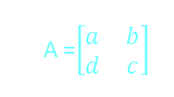




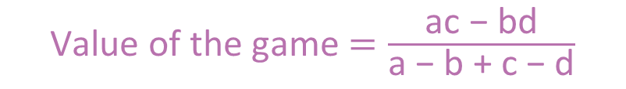
$$P_{1}=\frac{\text{c}\text{ − }\text{d}}{\text{(}\text{a}\text{ − }\text{b}\text{)+(}\text{c}\text{ − }\text{d}\text{)}}$$
Value of the game $=\frac{\text{ac}\text{ − }\text{bd}}{\text{a}\text{ − }\text{b}\text{ + }\text{c}\text{ − }\text{d}}$
List of formula to solve 2 X 2 matrix :-
A =$\left[\begin{matrix}a & b \\ d & c\end{matrix}\right]$
$$Q_{1}=\frac{\text{c}\text{ − }\text{b}}{\text{(}\text{a}\text{ − }\text{b}\text{)+(}\text{c}\text{ − }\text{d}\text{)}}$$
$P_{2}=$1- $P_{1}$
$Q_{2}=$1- $Q_{1}$

Slide 11
Definitions for formula List of formula that we are going to use

Slide 12
Solution of All 2 by 2 Matrix Games:-
Consider the general 2 × 2 game matrix
( )
A =
a b
C d
To solve this game (i.e. to find the value and at least one optimal strategy for each player) we proceed as follows.
Test for a saddle point.
If there is no saddle point, solve by finding equalizing strategies.
We now prove the method of finding equalizing strategies of Section 1.2 works whenever there is no saddle point by deriving the value and the optimal strategies.
Assume there is no saddle point. If a ≥ b, then bd, as otherwise c is a saddle point. Continuing thus, we see that db. In other words, if a ≥ b, then a>bd ca. This shows that If there is no saddle point, then either a>b, bd and da. In equations (1), (2) and (3) below, we develop formulas for the optimal strategies and value of the general 2 × 2 game. If I chooses the first row with probability p (i.e. uses the mixed strategy (p, 1 − p)), we equate his average return when II uses columns 1 and 2

Slide 13





v = ap + d(1 − p) = $=\frac{\text{ac}\text{ − }\text{bd}}{\text{a}\text{ − }\text{b}\text{ + }\text{c}\text{ − }\text{d}}$
$$\text{ap}\text{ + }\text{d}\text{(1 − }\text{p}\text{) = }\text{bp}\text{ + }\text{c}\text{(1 − }\text{p}\text{).}$$
Solving for p, we find
Since there is no saddle point, (a−b) and (c−d) are either both positive or both negative; hence, 0 <p< 1. Player I’s average return using this strategy is
If II chooses the first column with probability q (i.e. uses the strategy (q, 1−q)), we equate his average losses when I uses rows 1 and 2. aq + b(1 − q) = dq + c(1 − q) Hence,
Again, since there is no saddle point, 0 <q< 1. Player II’s average loss using this strategy is
the same value achievable by I. This shows that the game has a value, and that the players have optimal strategies. (something the minimax theorem says holds for all finite games).
p$=\frac{\text{c}\text{ − }\text{d}}{\text{(}\text{a}\text{ − }\text{b}\text{)+(}\text{c}\text{ − }\text{d}\text{)}}$
q$=\frac{\text{c}\text{ − }\text{b}}{\text{(}\text{a}\text{ − }\text{b}\text{)+(}\text{c}\text{ − }\text{d}\text{)}}$
aq + b(1 − q) $=\frac{\text{ac}\text{ − }\text{bd}}{\text{(}\text{a}\text{ − }\text{b}\text{)+(}\text{c}\text{ − }\text{d}\text{)}}$ = v

Slide 14
Few more examples To know the way of approach

Slide 15





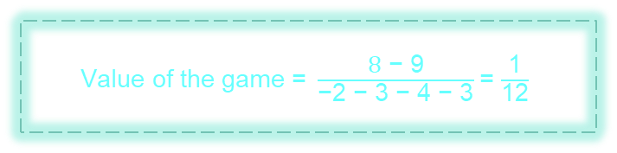
Example 2
$$A=\left[\begin{matrix}−2 & 3 \\ 3 & −4\end{matrix}\right]$$
$P_{1}\text{ =} \frac{\text{−4 − 3}}{\text{−2 − 3 − 4 − 3}}$= $\frac{\text{7}}{\text{1}\text{2}}$
$P_{2}\text{ =}\text{ 1} − \frac{\text{7}}{\text{1}\text{2}}$= $\frac{\text{5}}{\text{1}\text{2}}$
$Q_{1}\text{=} \frac{\text{−4 − 3}}{\text{−2 − 3 − 4 − 3}}$= $\frac{\text{7}}{\text{1}\text{2}}$
$Q_{2}\text{ =}\text{ 1} − \frac{\text{7}}{\text{1}\text{2}}$= $\frac{\text{5}}{\text{1}\text{2}}$
Value of the game $\text{=} \frac{\text{8}\text{ − }\text{9}}{\text{−2 − 3 − 4 − 3}}$= $\frac{\text{1}}{\text{1}\text{2}}$
Venus is the second planet from the Sun
Despite being red, Mars is a cold place
Mercury is the closest planet to the Sun
Mars
Mercury
Saturn
It’s the ringed one and a gas giant
It’s a gas giant and the biggest planet
Is the farthest planet from the Sun
Jupiter
Neptune

Slide 16





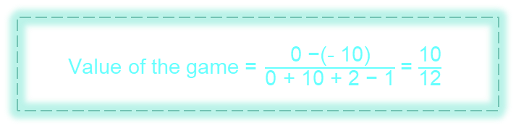
Example 3
$$B=\left[\begin{matrix}0 & −10 \\ 1 & 2\end{matrix}\right]$$
$P_{1}\text{ =} \frac{\text{2}\text{ − }\text{1}}{\text{0} \text{+} \text{10} \text{+} \text{2}\text{ − }\text{1}}$= $\frac{\text{1}}{\text{1}\text{1}}$
$P_{2}\text{ =}\text{ 1} −\frac{\text{1}}{\text{11}}$= $\frac{\text{1}\text{0}}{\text{11}}$
$Q_{1 }\text{=} \frac{\text{2} \text{+} \text{1}\text{0}}{\text{0} \text{+} \text{10} \text{+} \text{2}\text{ − }\text{1}}$= $\frac{\text{12}}{\text{1}\text{1}}$
$Q_{2}\text{ =}\text{ 1} −\frac{\text{12}}{\text{11}}$ = $\frac{−\text{1}}{\text{11}}$
Value of the game $\text{=} \frac{\text{0}\text{ −}\text{(−} \text{1}\text{0)}}{\text{0} \text{+} \text{10} \text{+} \text{2}\text{ − }\text{1}}$= $\frac{\text{10}}{\text{1}\text{2}}$
Venus is the second planet from the Sun
Despite being red, Mars is a cold place
Mercury is the closest planet to the Sun
Mars
Mercury
Saturn
It’s the ringed one and a gas giant
It’s a gas giant and the biggest planet
Is the farthest planet from the Sun
Jupiter
Neptune

Slide 17
Thank You

